Slide 1
Understanding Student Lifestyle Patterns and Their Impact on Academic Performance and Stress Levels

Slide 2
Author
SREERAJ CHINTHAM

Slide 3
INDEX
Questions Researched
Hypotheses
Motivation , Research Context and References
Dataset Info
Python Modules
Understanding and Preparing Variables

Slide 4
INDEX
Univariate , Bivariate and Multivariate Analysis
Graph Related to Research Questions
Correlation Matrix and HeatMap
Conclusion
Limitations
Opportunities and Suggestions

Slide 5
Questions Researched
What is the relationship between study hours and GPA?
Understanding this relationship can provide insights into whether increased study time leads to better academic performance or if there is a point of diminishing returns.
How do extracurricular activities affect GPA and stress levels?
This helps to explore whether balancing extracurricular activities contributes positively to academic performance or adds to student stress.
Does the number of sleep hours correlate with GPA and stress levels?
Sleep is crucial for cognitive functioning. Understanding this correlation can shed light on whether better sleep patterns contribute to improved academic outcomes and reduced stress.
What is the impact of physical activity on GPA and stress levels?
Physical activity is known to reduce stress and improve mental well-being. Determining its effect on academic performance and stress can guide recommendations for students.
Is there a significant difference in GPA or stress levels across different levels of social interaction?
This can reveal whether social engagement acts as a stress reliever or distractor for academic focus.

Slide 6
Hypotheses
H1: Students who study for more hours per day will have a higher GPA, but excessive study hours may lead to a plateau or even a decline in performance due to burnout.
Reason: Previous studies suggest a positive but nonlinear relationship between study time and performance.
H2: Moderate participation in extracurricular activities is positively correlated with GPA and negatively correlated with stress levels.
Reason: Balanced involvement in activities can improve time management and provide relaxation, enhancing overall outcomes.
H3: Students who sleep at least 7-9 hours per day will have higher GPAs and lower stress levels compared to those who sleep less or more.
Reason: Optimal sleep duration is linked to better cognitive functioning and emotional regulation.
H4: Regular physical activity is associated with lower stress levels and higher GPAs.
Reason: Physical activity promotes mental clarity and stress reduction, which can indirectly boost academic performance.
H5: Students with higher social hours per day may experience higher stress levels and potentially lower GPAs due to distraction, unless balanced well.
Reason: Excessive social engagement might detract from study time, but moderate levels can provide necessary emotional support.

Slide 7
Motivation for Research Questions
The motivation for analyzing these questions lies in the increasing challenges students face in balancing academic, personal, and social demands. With rising concerns about mental health, stress, and academic performance, it is crucial to identify patterns and actionable insights that can help students achieve better outcomes without compromising their well-being.
These research questions are worth exploring because they address the following key aspects:
Holistic Student Development: Understanding how lifestyle factors contribute to academic success and stress levels.
Actionable Insights: Providing students with evidence-based recommendations to optimize their routines.
Policy Implications: Informing educators and institutions about areas requiring intervention, such as promoting extracurricular activities or encouraging healthy sleep habits.

Slide 8
Research Context and Previous Work
Study Hours and GPA: Previous research suggests a positive correlation between study hours and academic performance but often highlights a plateau effect. For example, Plant et al. (2005) found that quality of study time often matters more than quantity, emphasizing strategic studying over prolonged hours.
Extracurricular Activities and GPA/Stress: Marsh (1992) proposed the "Participation-Identification Model," which indicates that involvement in structured extracurricular activities fosters a sense of belonging, improving academic motivation and reducing stress. However, over-commitment can lead to burnout, as noted by Fredricks (2011).
Sleep and Academic Performance/Stress: Numerous studies, including one by Wolfson & Carskadon (1998), indicate that students with regular sleep patterns and sufficient sleep duration perform better academically and report lower stress levels. Chronic sleep deprivation, on the other hand, impairs cognitive abilities and increases anxiety.

Slide 9
Research Context and Previous Work
Physical Activity and Stress/Academic Outcomes: Research by Hillman et al. (2008) demonstrates a positive link between physical activity and cognitive functioning, particularly in tasks requiring memory and attention. Regular exercise has also been shown to reduce cortisol levels, a biomarker for stress (Hamer, 2006).
Social Interaction and Stress/GPA: Studies like those by Thoits (1995) highlight the dual role of social interaction—it can serve as a source of emotional support, reducing stress, but excessive interaction may lead to distraction and time mismanagement, affecting academic outcomes negatively.

Slide 10
References
Study Hours and Academic Performance
Zimmerman, B. J., & Martinez-Pons, M. (1990). Student differences in self-regulated learning: Relating grade, sex, and giftedness to self-efficacy and strategy use. Journal of Educational Psychology, 82(1), 51–59. https://doi.org/10.1037/0022-0663.82.1.51
Nonis, S. A., & Hudson, G. I. (2006). Academic performance of college students: Influence of time spent studying and working. Journal of Education for Business, 81(3), 151-159. https://doi.org/10.3200/JOEB.81.3.151-159
Extracurricular Activities
Marsh, H. W. (1992). Extracurricular activities: Beneficial extension of the traditional curriculum or subversion of academic goals? Journal of Educational Psychology, 84(4), 553–562. https://doi.org/10.1037/0022-0663.84.4.553
Fredricks, J. A. (2011). Extracurricular participation and academic outcomes: Testing the over-scheduling hypothesis. Journal of Youth and Adolescence, 41(3), 295–306. https://doi.org/10.1007/s10964-011-9704-0

Slide 11
References
Sleep and Academic Performance
Wolfson, A. R., & Carskadon, M. A. (1998). Sleep schedules and daytime functioning in adolescents. Child Development, 69(4), 875–887. https://doi.org/10.1111/j.1467-8624.1998.tb06149.x
Shochat, T., Cohen-Zion, M., & Tzischinsky, O. (2014). Functional consequences of inadequate sleep in adolescents: A systematic review. Sleep Medicine Reviews, 18(1), 75–87. https://doi.org/10.1016/j.smrv.2013.03.005
Physical Activity and Academic Performance/Stress
Hillman, C. H., Erickson, K. I., & Kramer, A. F. (2008). Be smart, exercise your heart: Exercise effects on brain and cognition. Nature Reviews Neuroscience, 9(1), 58–65. https://doi.org/10.1038/nrn2298
Hamer, M. (2006). The relative influences of fitness and fatness on inflammatory factors. Preventive Medicine, 42(5), 355–362. https://doi.org/10.1016/j.ypmed.2006.01.011
Social Interaction and Stress
Thoits, P. A. (1995). Stress, coping, and social support processes: Where are we? What next? Journal of Health and Social Behavior, 35(Extra Issue), 53–79. https://doi.org/10.2307/2626957
Cohen, S., & Wills, T. A. (1985). Stress, social support, and the buffering hypothesis. Psychological Bulletin, 98(2), 310–357. https://doi.org/10.1037/0033-2909.98.2.310

Slide 12
DATASET INFO
Dataset Overview
The dataset, titled "Daily Lifestyle and Academic Performance of Students," is sourced from Kaggle at Student Lifestyle Dataset. It contains data collected via a Google Form survey, featuring responses from 2,000 students across India. The dataset covers the academic year from August 2023 to May 2024 and provides insights into students' daily habits and their relationships with academic performance and stress levels
Relevance and Usability
This dataset is a valuable resource for understanding how daily lifestyle habits such as studying, sleeping, and extracurricular involvement impact academic performance (CGPA) and stress levels. The focus on Indian students provides contextually specific insights, while the diverse variables enable the following analyses:
Correlations between time spent on activities and academic outcomes.
Patterns in stress levels across different lifestyle habits.
Actionable recommendations to optimize student lifestyles.

Slide 13
DATASET INFO
Variables Description
Student_ID
A unique identifier for each student in the dataset.
Type: Qualitative (Nominal).
Study_Hours_Per_Day
The average number of hours a student spends studying daily.
Type: Quantitative (Ratio).
Unit: Hours.
Extracurricular_Hours_Per_Day
The average number of hours a student spends on extracurricular activities each day.
Type: Quantitative (Ratio).
Unit: Hours.
Sleep_Hours_Per_Day
The average number of hours a student sleeps per day.
Type: Quantitative (Ratio).
Unit: Hours.

Slide 14
DATASET INFO
Variables Description
5. Social_Hours_Per_Day
The average number of hours a student spends on social interactions daily.
Type: Quantitative (Ratio).
Unit: Hours.
6. Physical_Activity_Hours_Per_Day
The average number of hours a student spends on physical activities daily.
Type: Quantitative (Ratio).
Unit: Hours.
7. Stress_Level
The perceived stress level of a student, categorized as Low, Moderate, or High.
Type: Qualitative (Ordinal).
8. CGPA
The cumulative grade point average representing the academic performance of the student.
Type: Quantitative (Interval).

Slide 15
PYTHON MODULES
NUMPY
PANDAS
MATPLOTLIB.PYPLOT
SEABORN

Slide 16
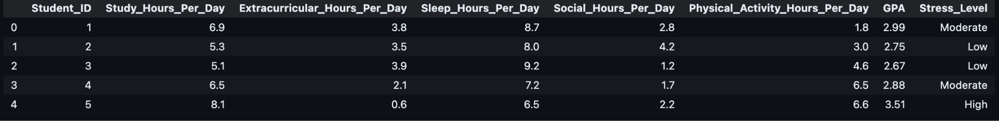
UNDERSTANDING AND PREPARING THE DATA
LOADING THE DATA
import pandas as pd
stud_df = pd.read_csv("student.csv")
CHECKING THE DATA
stud_df.head()
The HEAD function returns First five rows or records of the Dataset.

Slide 17

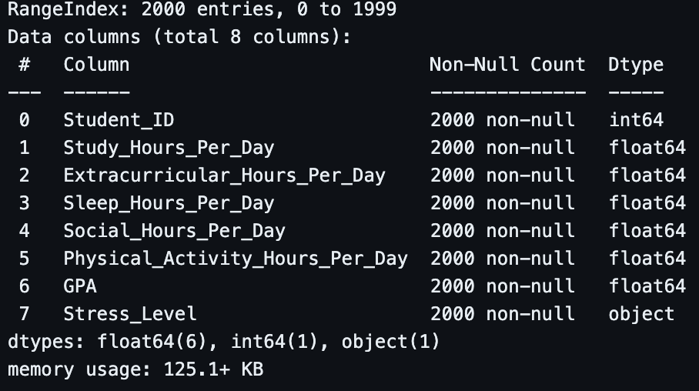
UNDERSTANDING AND PREPARING THE DATA
GETTING THE SHAPE AND INFO
Stud_df.shape
The SHAPE function returns a tuple with format (number of rows,number of columns). This Dataset Contains 2000 Rows and 8 Columns.
stud_df.info()
The INFO() function returns the info of each column which is the respective data type and count. It makes it easier to know and perform operations on

Slide 18
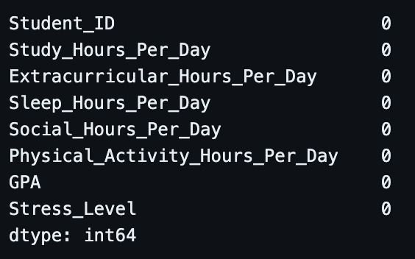
UNDERSTANDING AND PREPARING THE DATA
CLEANING THE DATA
stud_df.isna().sum()
The isna().sum() is used to find out the null values in each column. The Dataset contains no null values. The dropna() is used to remove all the null values.

Slide 19
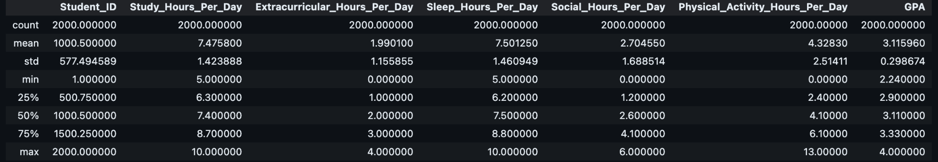
UNDERSTANDING AND PREPARING THE DATA
stud_df.describe()
The describe() function is used to describe data of each column with the statistics as follows:
As we can see the mean value and 50 percentile or median are close to each other in value which signifies that there no outliers that affect the dataset.

Slide 20
UNIVARIATE ANALYSIS
Introduction to Univariate Analysis
Univariate Analysis focuses on examining each variable in isolation to understand its underlying properties and behavior. Here's how we approach it:
For Quantitative Variables
Central Tendency Explore typical values using mean, median, and mode.
Spread Assess variability with standard deviation, variance, minimum, and maximum.
Visualization Use histograms, box plots, and density plots to uncover patterns and detect outliers.

Slide 21
UNIVARIATE ANALYSIS
For Qualitative Variables
Frequency Analysis Identify category counts to understand distribution across groups.
Visualization Represent trends effectively using bar charts and pie charts.
Objective: To gain a comprehensive understanding of individual variables, laying the groundwork for further analysis and hypothesis testing.

Slide 22
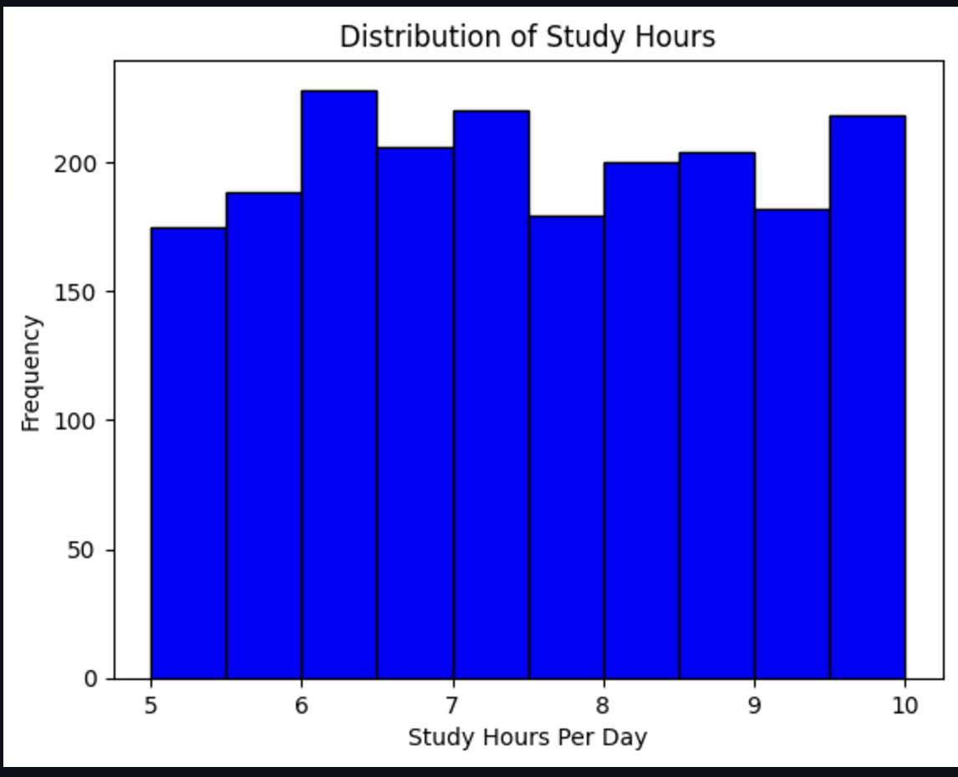
UNIVARIATE ANALYSIS
1. Distribution of Study Hours
import matplotlib.pyplot as plt
plt.hist(stud_df["Study_Hours_Per_Day"], bins=10, color='blue', edgecolor='black')
plt.title('Distribution of Study Hours')
plt.xlabel('Study Hours Per Day')
plt.ylabel('Frequency')
plt.show()
The histogram represents the frequency distribution of daily study hours among students.
The distribution appears relatively uniform, with study hours ranging from 5 to 10 hours per day.
The most frequent study hours are approximately 7 to 8 hours, with other intervals (e.g., 6, 9, and 10 hours) showing comparable frequencies.

Slide 23
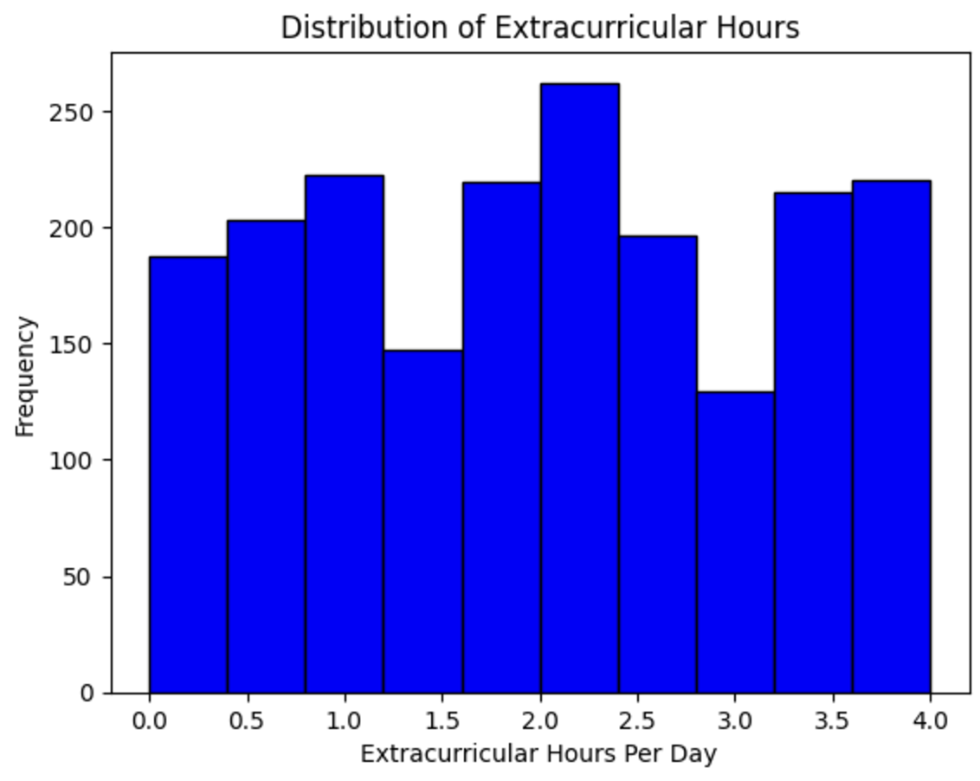
UNIVARIATE ANALYSIS
2. Distribution of Extracurricular Hours
plt.hist(stud_df["Extracurricular_Hours_Per_Day"], bins=10, color='blue', edgecolor='black')
plt.title('Distribution of Extracurricular Hours')
plt.xlabel('Extracurricular Hours Per Day')
plt.ylabel('Frequency')
plt.show()
The histogram represents the frequency distribution of Extra Curricular hours among students.
The distribution appears relatively uniform, with hours ranging from 0 to 4 hours per day.
The most frequent hours are approximately 2 to 2.5 hours, with other intervals (e.g., 1.0, 3.5 and 4.0 hours) showing comparable frequencies.

Slide 24
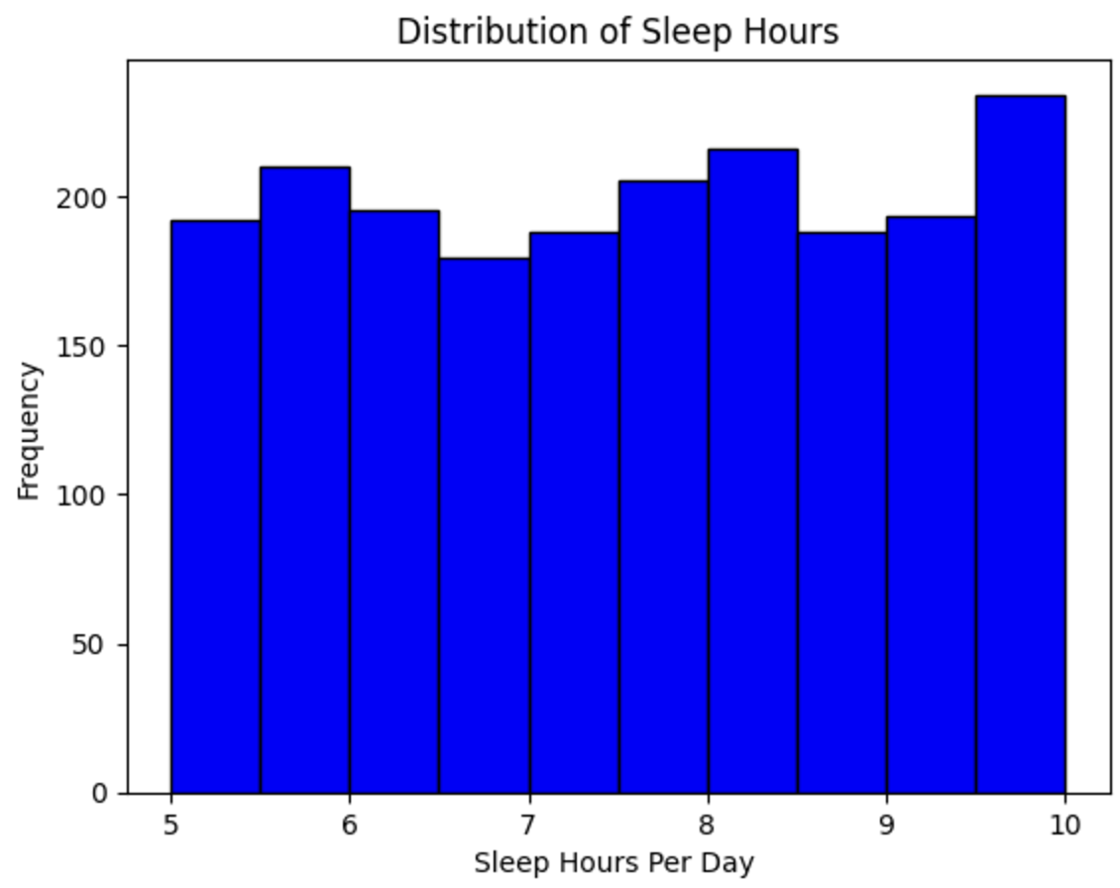
UNIVARIATE ANALYSIS
3. Distribution of Sleep Hours
plt.hist(stud_df["Sleep_Hours_Per_Day"], bins=10, color='blue', edgecolor='black')
plt.title('Distribution of Sleep Hours')
plt.xlabel('Sleep Hours Per Day ')
plt.ylabel('Frequency')
plt.show()
The histogram represents the frequency distribution of Sleep hours among students.
The distribution appears relatively uniform, with sleep hours ranging from 5 to 10 hours per day.
The most frequent sleep hours are approximately 9.5 to 10 hours, with other intervals (e.g., 6 and 8 hours) showing comparable frequencies.

Slide 25
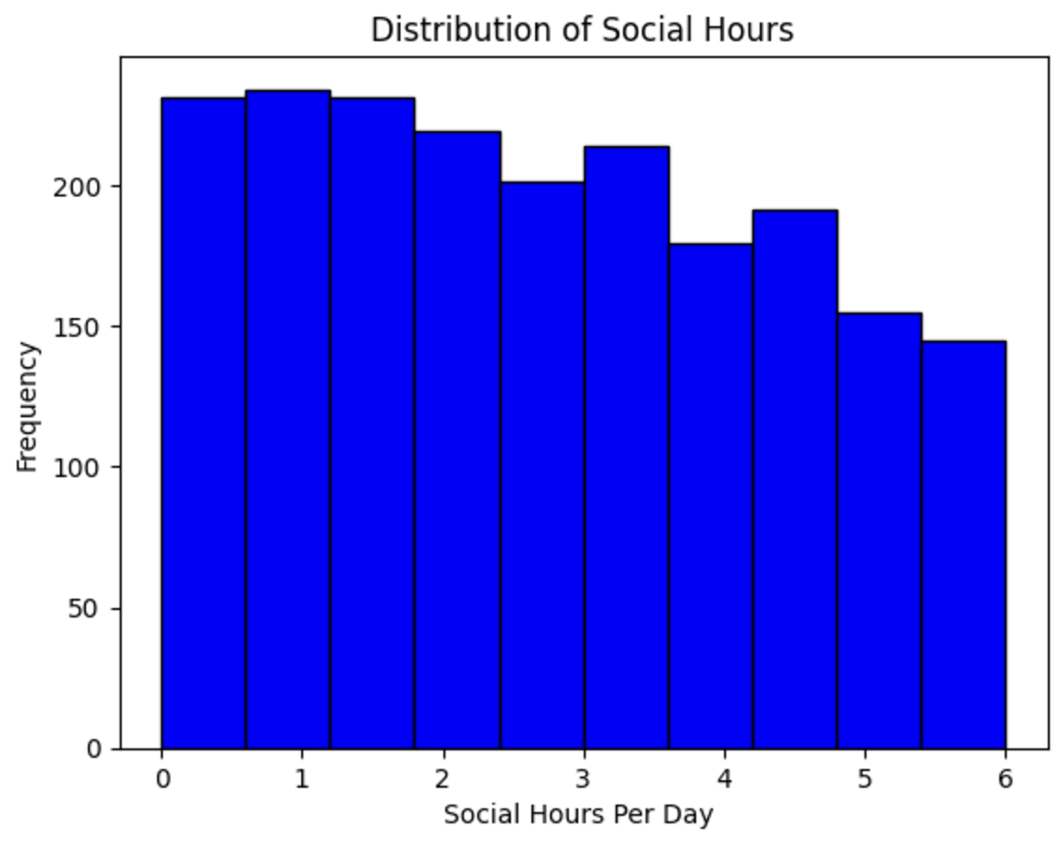
UNIVARIATE ANALYSIS
4.Distribution of Social Hours
plt.hist(stud_df["Social_Hours_Per_Day"], bins=10, color='blue', edgecolor='black')
plt.title('Distribution of Social Hours')
plt.xlabel('Social Hours Per Day ')
plt.ylabel('Frequency')
plt.show()
The histogram represents the frequency distribution of Social hours among students.
The distribution appears relatively uniform but with downward slope, with study hours ranging from 0 to 6 hours per day.
The most frequent study hours are approximately 0 to 2 hours, with no other intervals showing comparable frequencies.

Slide 26
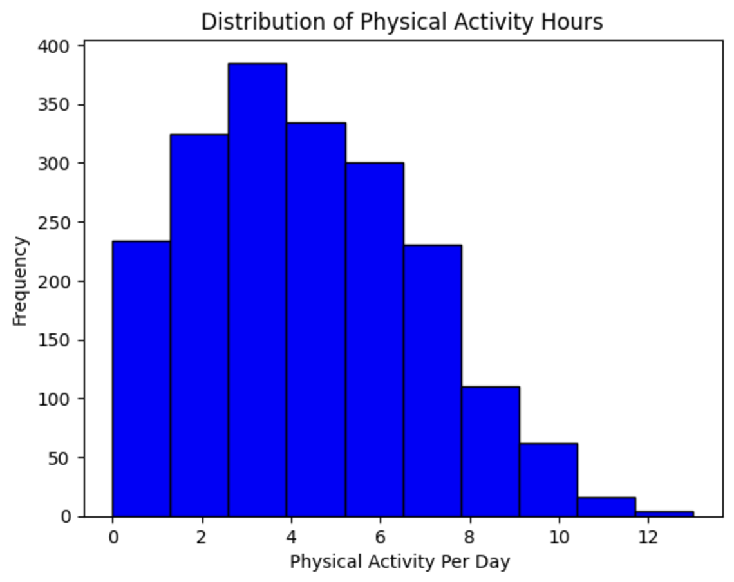
UNIVARIATE ANALYSIS
5. Distribution of Physical Activity Hours
plt.hist(stud_df["Physical_Activity_Hours_Per_Day"], bins=10, color='blue', edgecolor='black')
plt.title('Distribution of Physical Activity Hours')
plt.xlabel('Physical Activity Per Day ')
plt.ylabel('Frequency')
plt.show()
The histogram represents the frequency distribution of Physical Activity hours among students.
The distribution appears to be normal but with right skew, with hours ranging from 0 to 12 hours per day.
The most frequent hours are approximately 2 to 4 hours, with no other intervals showing comparable frequencies.

Slide 27
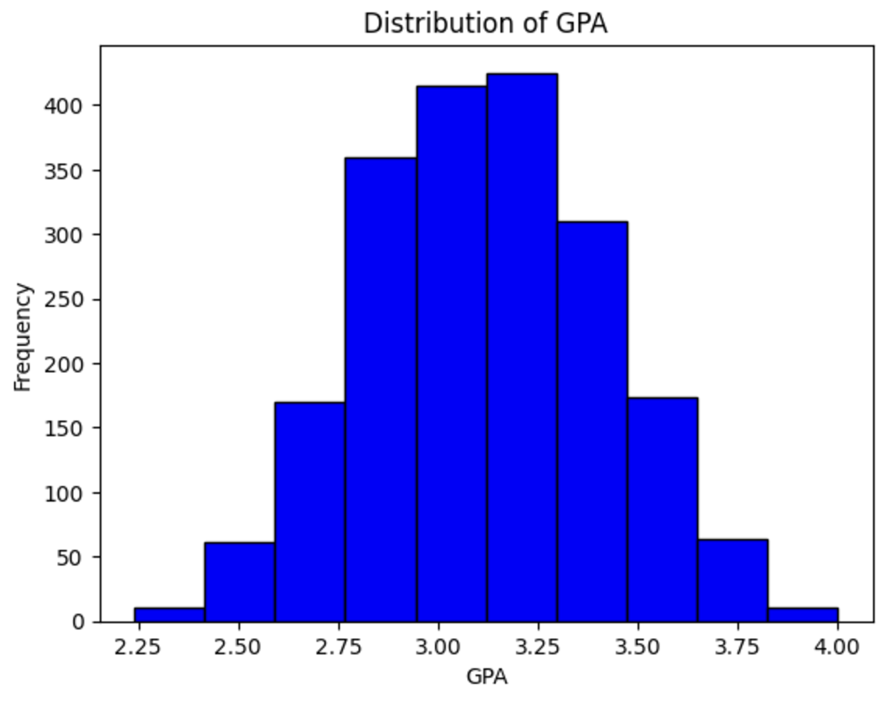
UNIVARIATE ANALYSIS
6. Distribution of GPA
plt.hist(stud_df["GPA"], bins=10, color='blue', edgecolor='black')
plt.title('Distribution of GPA')
plt.xlabel('GPA')
plt.ylabel('Frequency')
plt.show()
The histogram represents the frequency distribution of GPA among students.
The distribution appears to be normal but with left skew, with GPA ranging from 0 to 4.
The most frequent GPA are approximately 3 to 3.25, with no other intervals showing comparable frequencies.

Slide 28
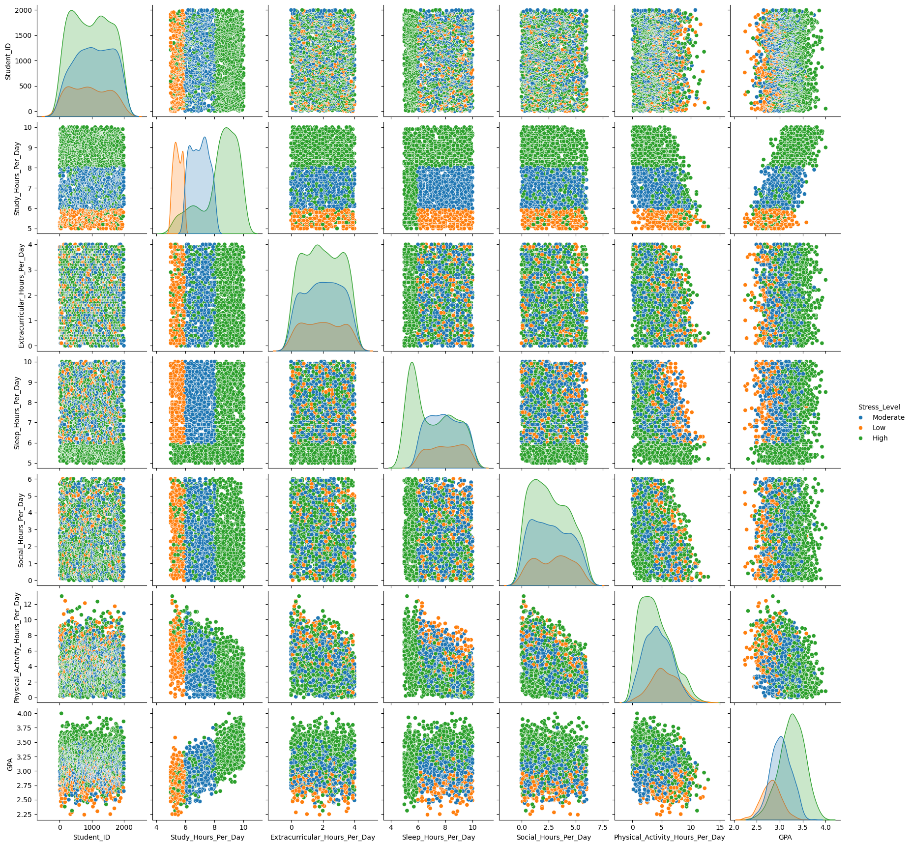
MULTIVARIATE ANALYSIS
PAIRPLOT
Import seaborn as sns
sns.pairplot(stud_df, hue="Stress_Level")
pairplot() is a method used to plot scatterplots between each of the features by selecting two at a time.
Although it is a Bivariate Analysis. By using “hue=” argument we can make it a Trivariate Analysis As follows.
From the following Pairplot We can take a few plots which are useful to make conclusions because of their relative separation.

Slide 29
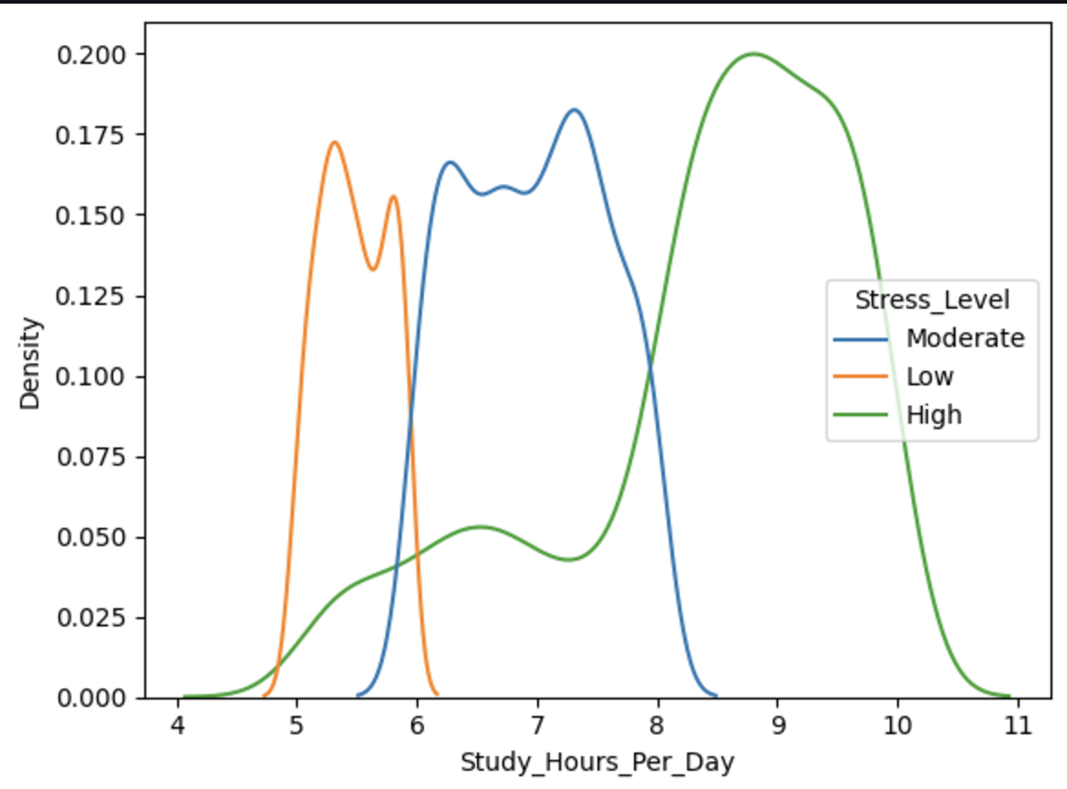
BIVARIATE ANALYSIS
sns.kdeplot(data=stud_df,x='Study_Hours_Per_Day', hue ="Stress_Level")
From the following density plot of the Study hours per day we can assume that if the Study hours are more than 8.5 hours then the stress level of the student is “High”.
Also, if the Study hours per day are less than 8.5 hours then the stress levels might not be “High” with a low probability of error.

Slide 30
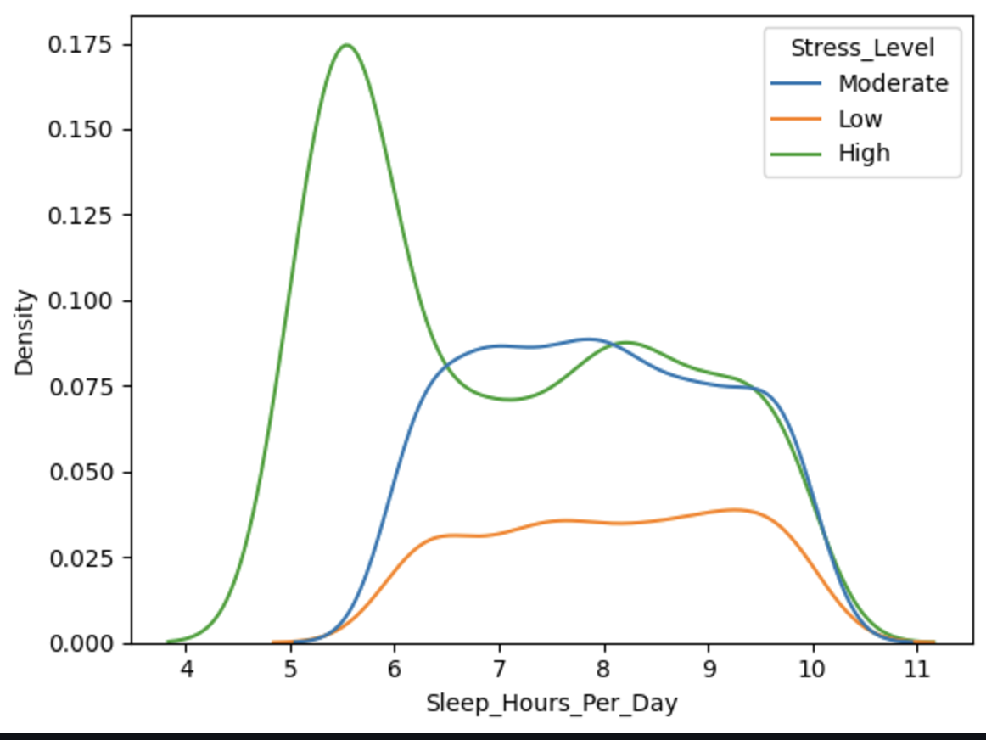
BIVARIATE ANALYSIS
sns.kdeplot(data=stud_df,x='Sleep_Hours_Per_Day', hue ="Stress_Level")
From the graph we can summarize that:
People who sleep less than 5 hours tend to be more stressed which is showed by the green line.
Majority of the people sleep 5 to 6 hours which can be correlated to High Stress levels.

Slide 31
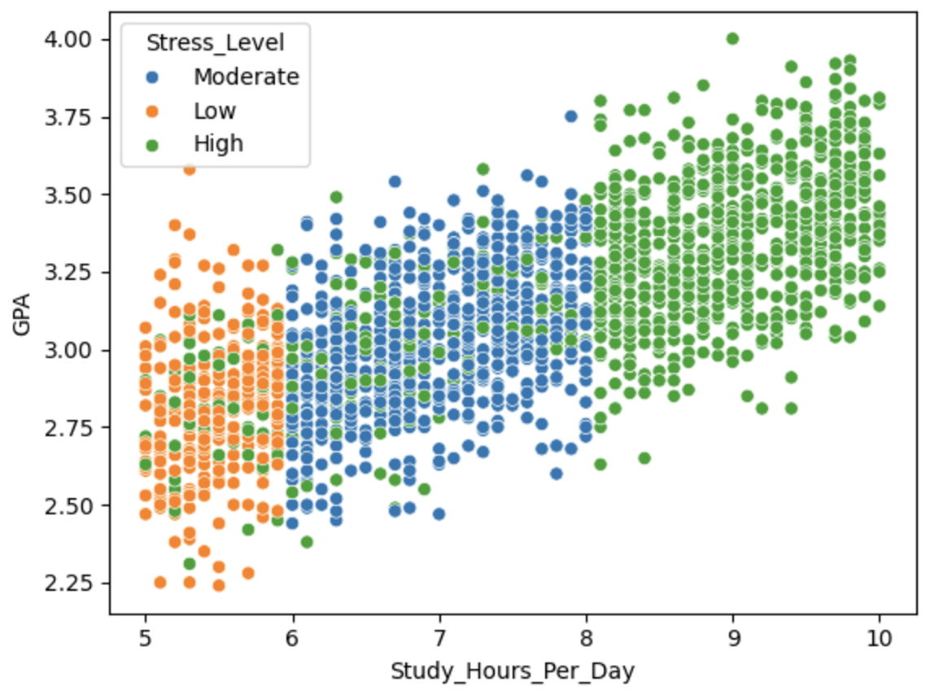
STUDY HOURS VS GPA
sns.scatterplot(x= stud_df["Study_Hours_Per_Day"],y = stud_df["GPA"] ,hue =stud_df["Stress_Level"])
This is a scatter plot showing the relationship between Study Hours Per Day (on the x-axis) and GPA (on the y-axis), with points color-coded based on Stress Level.
Key Observations:
X-Axis: Represents the number of hours spent studying per day.
Y-Axis: Represents the GPA (Grade Point Average), ranging from approximately 2.25 to 4.0.
Insights:
Low stress levels are more common with shorter study durations and tend to correlate with lower GPAs.
Moderate stress levels are distributed in a mid-range of study hours and GPA values, indicating a balance.
High stress levels align with increased study hours, often corresponding to higher GPAs, although some high-stress individuals also experience lower GPA outcomes.
This plot highlights a potential trade-off between stress, study time, and academic performance. It suggests that while high stress and long study hours may lead to high GPAs for some, they can also result in inconsistent outcomes for others.

Slide 32
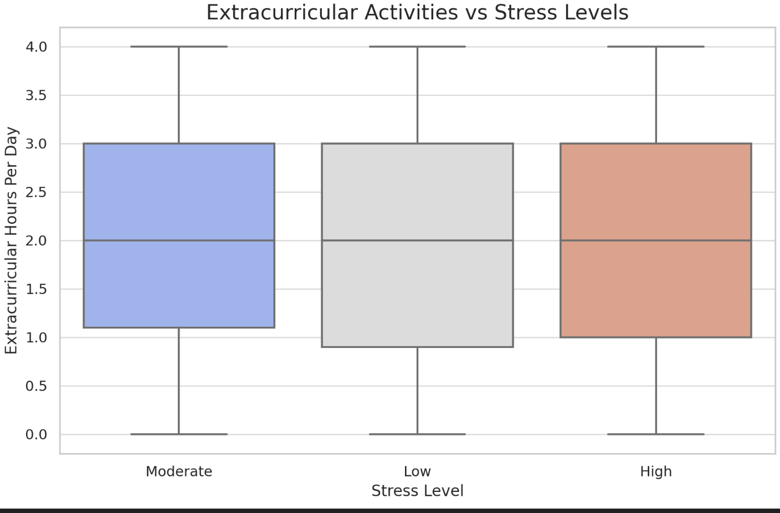
BOX PLOT - EXTRACURRICULAR HOURS VS STRESS LEVELS
The image shows a box plot that compares extracurricular hours per day across three categories of stress levels: Moderate, Low, and High.
Axes:
Y-axis: Represents the number of extracurricular hours per day (ranging from 0 to 4).
X-axis: Represents stress levels categorized as Moderate, Low, and High.
Box Plot Elements:
Boxes: Represent the interquartile range (IQR), which is the range between the 25th percentile (bottom of the box) and the 75th percentile (top of the box).
Horizontal Line inside the Box: Indicates the median (50th percentile) value of extracurricular hours.
Whiskers: Extend to show the minimum and maximum values within 1.5 times the IQR.
Observations:
Moderate Stress:
Median extracurricular hours are about 2.
Most values range between 1.5 and 3.
Low Stress:
Median extracurricular hours are slightly higher than Moderate, around 2.5.
Hours range widely between 0 and about 4.
High Stress:
Median is similar to Moderate, around 2.
The IQR (spread) is also comparable to Moderate stress levels

Slide 33
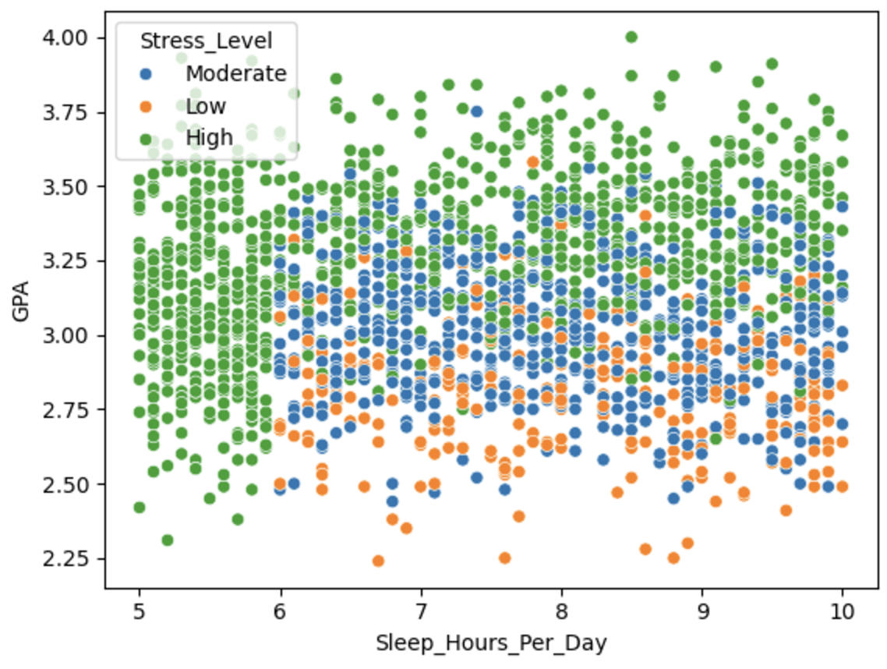
SLEEP HOURS VS GPA
sns.scatterplot(x= stud_df["Sleep_Hours_Per_Day"],y = stud_df["GPA"] ,hue =stud_df["Stress_Level"])
This image is a scatter plot that shows the relationship between sleep hours per day and GPA, with points color-coded by stress levels.
Axes:
X-axis: Represents Sleep Hours Per Day, ranging from approximately 5 to 10 hours.
Y-axis: Represents GPA, ranging from about 2.25 to 4.0.
Legend and Color Coding:
Moderate Stress Level: Blue dots.
Low Stress Level: Green dots.
High Stress Level: Orange dots.
Pattern of Data Points:
The distribution appears dense between 6 and 9 hours of sleep, with a wider spread in GPA values in this range.
At lower sleep hours (5–6), GPA values are generally lower and skewed toward the 2.5–3.0 range.
As sleep hours increase (7–10), GPA values tend to cluster higher, with many closer to the 3.5–4.0 range.
Stress levels and GPA:
High stress (orange) points are scattered more toward the lower end of GPA and sleep hours.
Moderate stress (blue) points are evenly distributed across GPA values and sleep hours.
Low stress (green) points dominate higher GPA and sleep hour ranges.

Slide 34
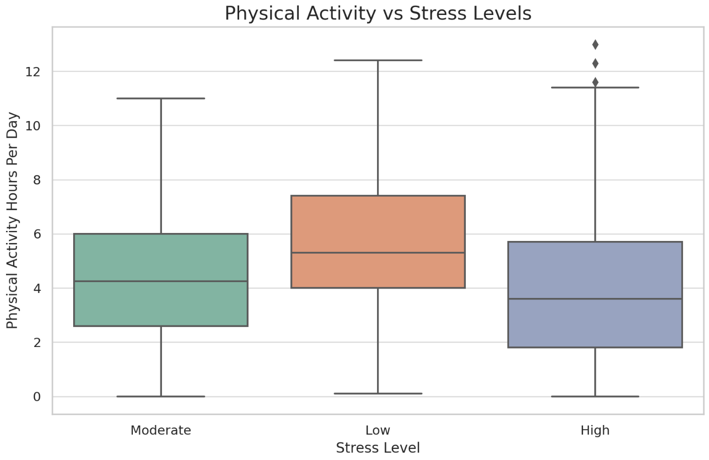
PHYSICAL ACTIVITY VS STRESS LEVEL -
BOX PLOT
This image displays a box plot comparing physical activity hours per day across three categories of stress levels: Moderate, Low, and High.
Axes:
Y-axis: Represents Physical Activity Hours Per Day, ranging from 0 to about 12 hours.
X-axis: Represents Stress Level (Moderate, Low, High).
Box Plot Features:
Moderate Stress (Green Box):
Median physical activity is approximately 4 hours per day.
The interquartile range (IQR) spans from about 2 to 6 hours.
Whiskers extend from 0 to approximately 10 hours, showing a wide variability in activity levels.
Low Stress (Orange Box):
Median physical activity is slightly higher, around 5 hours.
The IQR spans from 3 to 8 hours.
Whiskers extend to around 12 hours, indicating a few individuals with very high activity levels.

Slide 35
PHYSICAL ACTIVITY VS STRESS LEVEL -
BOX PLOT
High Stress (Blue Box):
Median physical activity is about 3 hours, slightly lower than the other categories.
The IQR spans from 1 to 6 hours.
Whiskers and a few outliers extend past 10 hours, showing a smaller group with exceptionally high activity levels.
Key Observations:
Those with low stress tend to have the highest median and widest range of physical activity hours.
Individuals with moderate stress exhibit moderate activity levels.
Those with high stress show slightly lower median physical activity levels but still maintain variability.

Slide 36
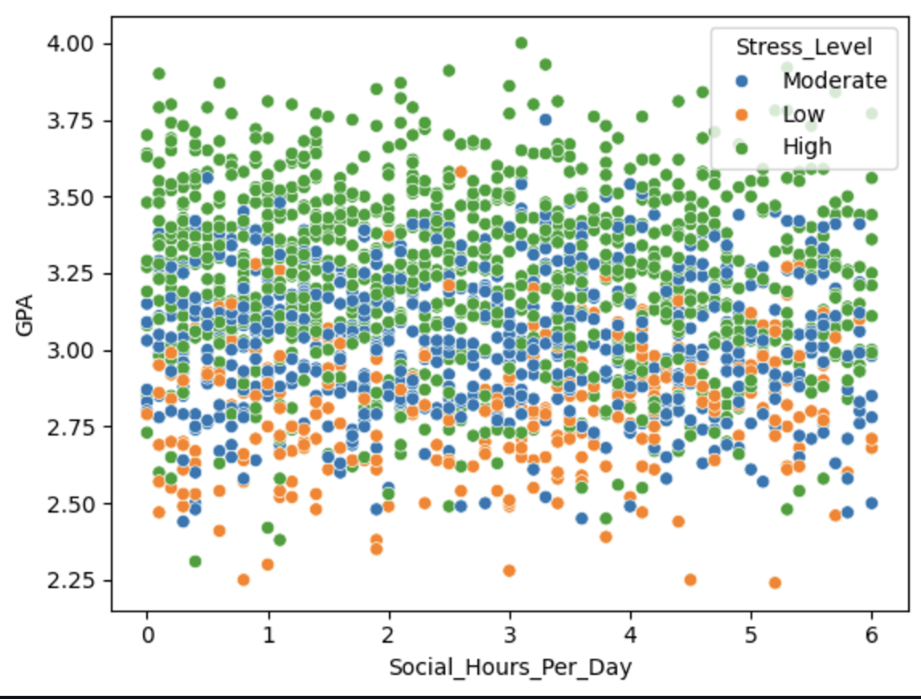
SOCIAL HOURS VS GPA
This scatter plot illustrates the relationship between Social Hours Per Day (x-axis) and GPA (y-axis). The data points are categorized by Stress Level, represented with different colors:
Blue: Moderate stress level
Green: Low stress level
Orange: High stress level
Observations:
GPA Distribution: The GPA values range from 2.25 to 4.00. There is a concentration of GPAs between 3.0 and 3.75 across most social hour ranges.
Social Hours: Social hours range from 0 to approximately 6 hours per day.
Stress Levels:
Individuals with high stress levels (green) appear evenly spread across different social hours and GPA levels.
Those with moderate stress levels (blue) dominate the distribution, particularly around mid-range GPAs.
Individuals with low stress levels (orange) are relatively fewer and show up sporadically, often clustering at lower GPAs.
This chart provides a visual representation of how social habits and stress levels potentially correlate with academic performance.

Slide 37
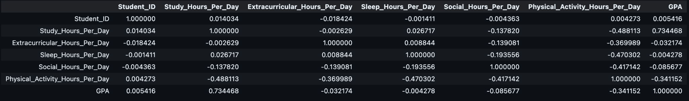
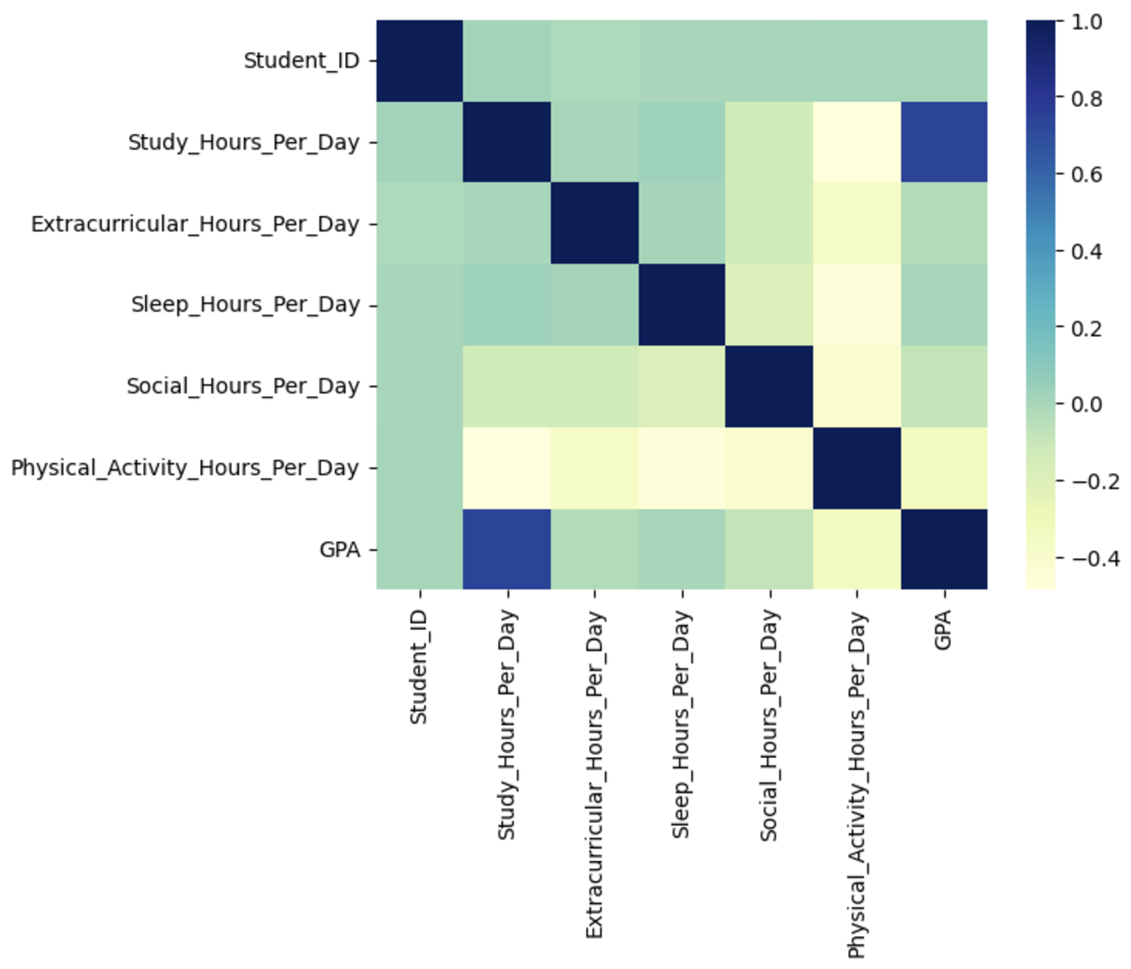
CORRELATION MATRIX AND CORRELATION HEAT MAP
This is a Correlation Matrix for the Dataset without the stress_Level
Observations:
Study Hours vs. GPA: Strong positive correlation (0.734). Increased study hours are associated with higher GPAs.
Extracurricular Hours vs. GPA: Weak negative correlation (-0.032). Extracurricular hours have a minimal impact on GPA.
Sleep Hours vs. GPA: Almost no correlation (-0.004). Sleep hours don’t strongly influence GPA directly in this dataset.
Physical Activity vs. GPA: Moderate negative correlation (-0.341). Excessive physical activity might detract from academic performance.
Social Hours vs. GPA: Weak negative correlation (-0.086). Higher social interaction slightly correlates with lower GPAs.

Slide 38
ANSWERING THE QUESTIONS
1. Study Hours vs. GPA
Relationship:
Strong positive correlation (0.734): Increased study hours generally lead to higher GPAs.
Diminishing Returns: While more study hours improve GPA up to a certain level, excessive study hours might correlate with lower efficiency, higher stress, or limited time for rest and other activities.
Insights:
Optimal study time likely falls within a range where students can balance preparation without overextending themselves.
A balanced approach (including breaks, sleep, and extracurriculars) is important for sustained performance.
2. Extracurricular Activities vs. GPA and Stress Levels
Impact on GPA:
Weak negative correlation (-0.032): Extracurricular hours have minimal impact on GPA.
Moderate extracurricular involvement likely aids time management and reduces stress, indirectly benefiting GPA.
Impact on Stress Levels:
Students with more extracurricular hours report lower stress levels, suggesting that such activities provide relaxation, fulfillment, or social support.
Overcommitment to extracurriculars might cause stress if it cuts into time needed for academics or rest.
Insights:
Balancing extracurricular activities (e.g., ~2-4 hours/day) helps students stay engaged without detracting significantly from academics.

Slide 39
ANSWERING THE QUESTIONS
3. Sleep Hours vs. GPA and Stress Levels
Correlation with GPA:
Almost no correlation (-0.004): Sleep hours do not directly influence GPA in the dataset.
However, adequate sleep is known to improve focus, memory, and cognitive functioning, which are crucial for academic performance.
Correlation with Stress Levels:
More sleep correlates with lower stress. Students with less sleep (<6 hours/day) tend to report higher stress levels.
Insights:
While sleep hours might not directly affect GPA, their impact on stress reduction and cognitive health is significant.
Students should prioritize 6-8 hours of sleep for overall well-being and indirect academic benefits.
4. Physical Activity vs. GPA and Stress Levels
Impact on GPA:
Moderate negative correlation (-0.341): Excessive physical activity can detract from GPA, likely due to reduced study time.
Moderate physical activity (~1-3 hours/day) may indirectly improve academic performance by reducing stress and boosting focus.
Impact on Stress Levels:
Strong negative impact on stress: More physical activity correlates with significantly lower stress levels.
Physical activity acts as a stress reliever and improves mental health.
Insights:
Regular exercise (~1-2 hours/day) provides a balance, reducing stress without affecting academics adversely.

Slide 40
ANSWERING THE QUESTIONS
5. Social Interaction vs. GPA and Stress Levels
Impact on GPA:
Weak negative correlation (-0.086): Excessive social interaction (>3 hours/day) might reduce focus on academics, leading to lower GPAs.
Students with moderate social interaction (~1-2 hours/day) tend to perform better academically.
Impact on Stress Levels:
Students with limited social interaction (<1 hour/day) report higher stress levels, likely due to isolation and lack of emotional support.
Excessive social interaction (>3 hours/day) can also add stress if it disrupts academics or rest.
Insights:
Moderate social interaction is beneficial for both stress relief and academic focus. A balance is key to maintaining overall well-being.
Summary Recommendations
Study Hours: Aim for an optimal range of 6-8 hours/day. Avoid overstudying as it may lead to diminishing returns.
Extracurricular Activities: Encourage 2-4 hours/day for reduced stress and better balance. Overcommitment should be avoided.
Sleep: Prioritize 6-8 hours of sleep for stress reduction and cognitive health.
Physical Activity: Regular exercise (~1-2 hours/day) is essential for stress management and overall well-being.
Social Interaction: Maintain 1-2 hours/day of meaningful social interactions to balance academics and mental health.

Slide 41
LIMITATIONS
While the analysis provides valuable insights into the relationships between variables (study hours, GPA, stress levels, etc.), several limitations could impact the accuracy and depth of the findings:
1. Correlation ≠ Causation
Issue: While relationships (correlations) are identified, the analysis does not establish causation. For instance:
Higher study hours correlate with higher GPA, but it does not confirm whether more study hours cause better academic performance.
Sleep hours and stress levels may be correlated, but external factors (e.g., deadlines) could also influence stress.
Impact: Misinterpretation of relationships can lead to oversimplified conclusions.
2. Lack of External Context
Issue: The analysis does not account for external factors, such as:
Socioeconomic background
Access to resources (tutors, extracurricular facilities)
Type of academic institution or curriculum difficulty
Impact: The findings may not generalize to all student populations.

Slide 42
LIMITATIONS
3. Uniformity in Data Range
Issue: Many variables (e.g., study hours) have a narrow range, making it challenging to observe patterns like diminishing returns.
Impact: Subtle effects (e.g., the impact of extremely high or low study hours) may not be captured effectively.
4. Oversimplification of Stress Levels
Issue: Stress levels are categorized into "Low," "Moderate," and "High," which may oversimplify a complex psychological factor.
Impact: This approach could obscure finer distinctions within each stress category and their impact on other variables.
5. Potential Data Quality Issues
Issue: The quality of the dataset is unclear:
Were variables self-reported (e.g., stress levels, GPA)? If so, there could be biases.
Are there any missing or inaccurate data points?
Impact: Inaccurate or incomplete data may reduce the reliability of conclusions.

Slide 43
LIMITATIONS
6. Limited Variables
Issue: The dataset does not include variables like:
Mental health conditions
Peer influence
Academic support or teaching quality
Impact: Important factors that could provide more context to stress and GPA are excluded.
7. Sample-Specific Findings
Issue: The analysis is based on a specific dataset, which may not reflect broader student populations.
Impact: Results might not generalize across different regions, age groups, or educational settings.
8. Non-Linear Relationships
Issue: Some relationships might be non-linear, but the analysis primarily assumes linear trends in visualizations.
Impact: Important nuances, like thresholds or diminishing returns (e.g., studying beyond 8 hours having minimal GPA impact), might be missed.
9. Unexamined Interactions
Issue: Interactions between multiple variables (e.g., how sleep and physical activity jointly affect GPA) are not analyzed.
Impact: Overlooking these relationships could limit deeper insights into student performance and well-being.

Slide 44
OPPORTUNITIES AND SUGGESTIONS
1. Establish Causation
Use regression models or causal inference techniques to identify the factors that directly influence GPA and stress, moving beyond simple correlations.
2. Expand Data Variables
Collect additional data, such as mental health metrics, socioeconomic factors, and academic workload, for a more comprehensive analysis.
3. Explore Non-Linear Relationships
Investigate diminishing returns (e.g., the plateau effect of study hours) and non-linear trends using advanced statistical models.
4. Improve Data Quality
Ensure data accuracy by collecting institutional records for GPA and validated tools for stress assessment, minimizing self-report bias.
5. Analyze Variable Interactions
Study how combinations of variables (e.g., sleep and physical activity) jointly affect GPA and stress for deeper insights.

Slide 45
OPPORTUNITIES AND SUGGESTIONS
6. Collect Longitudinal Data
Track changes over time to understand how habits and stress levels evolve during academic terms and their long-term effects.
7. Provide Practical Recommendations
Use findings to suggest optimal study hours, extracurricular involvement, and sleep schedules tailored to students' needs.
8. Identify Stress Triggers
Analyze data on stress sources (e.g., academic pressure or lack of sleep) and assess the effectiveness of coping mechanisms.
9. Generalize Across Populations
Validate findings across diverse student groups to ensure that conclusions apply broadly, not just to a specific sample.
10. Develop Visualization Tools
Create interactive dashboards or apps to present insights clearly and offer actionable advice to students, parents, and educators.

Slide 46
THANK YOU

